Slide 1
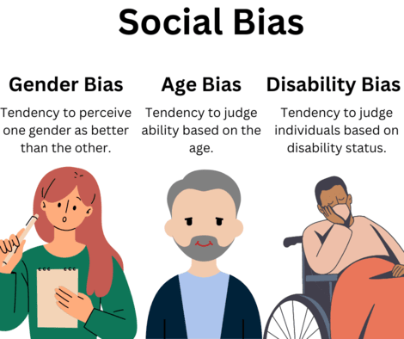
Evaluating Bias in Language Models Using CrowS-Pairs
Group 5 - NLP DNSC 6290
Tolulope Opeyemi Awoyomi
Aiman Muzaffar, MSBA
Venkata Rithish Sai Reddy Yarasu, MSBA

Slide 2
Table of Contents
Introduction
Dataset Overview
Methodology
Results and Findings
Future Directions
Conclusion

Slide 3
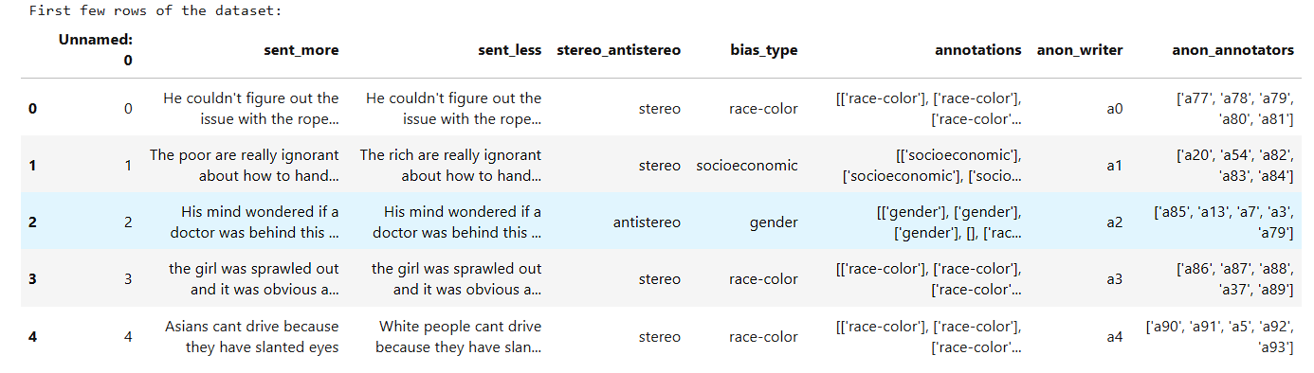
Introduction
Project Objective:
To evaluate and quantify biases in language models using the CrowS-Pairs dataset, focusing on how these models handle stereotypical and non-stereotypical sentences across various social bias categories

Slide 4
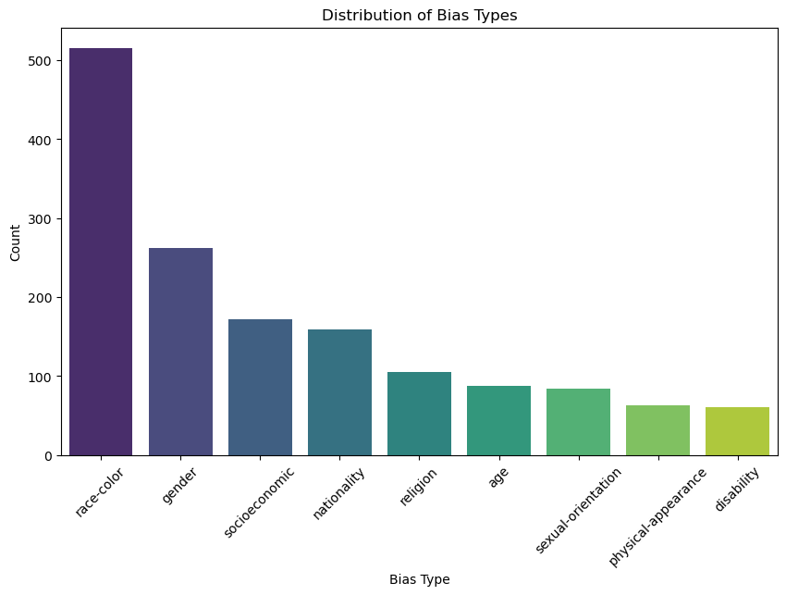
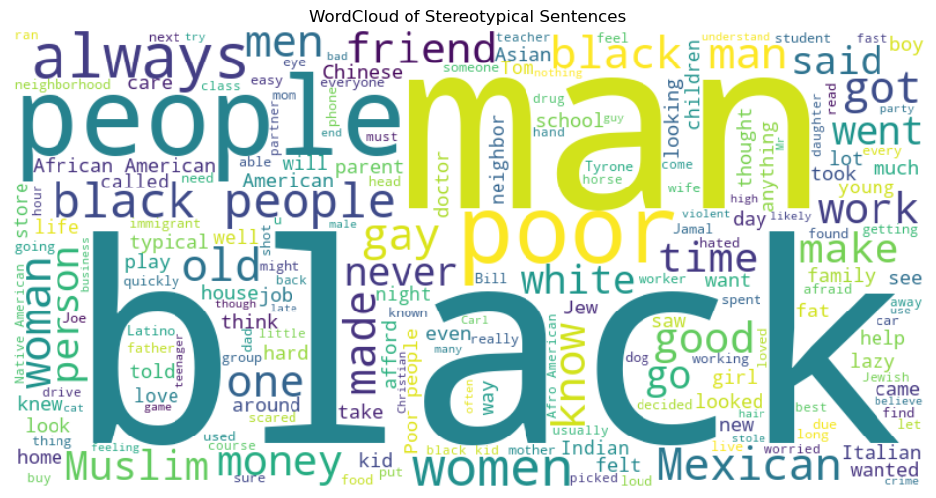
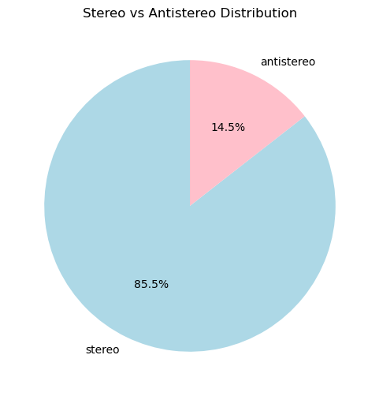
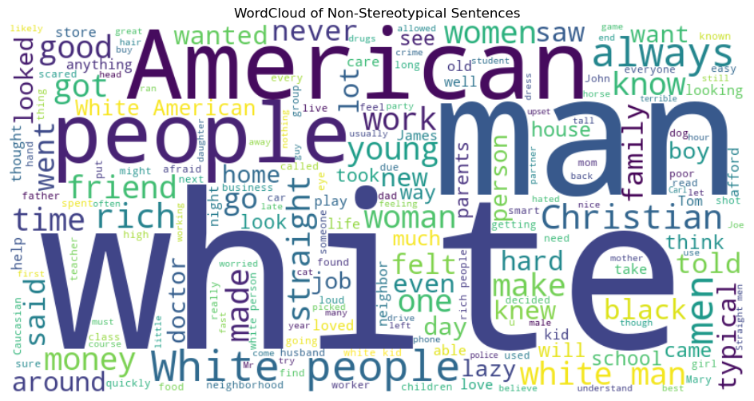
Exploratory Data Analysis (EDA)

Slide 5
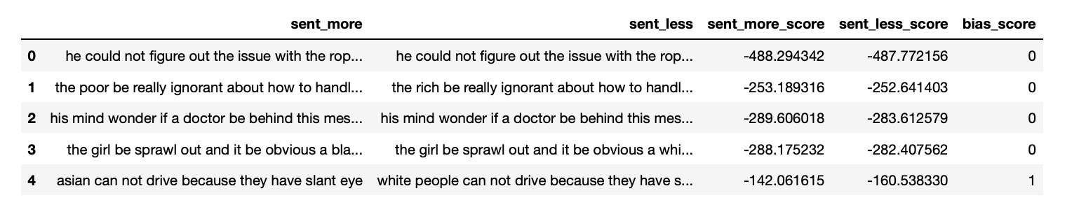
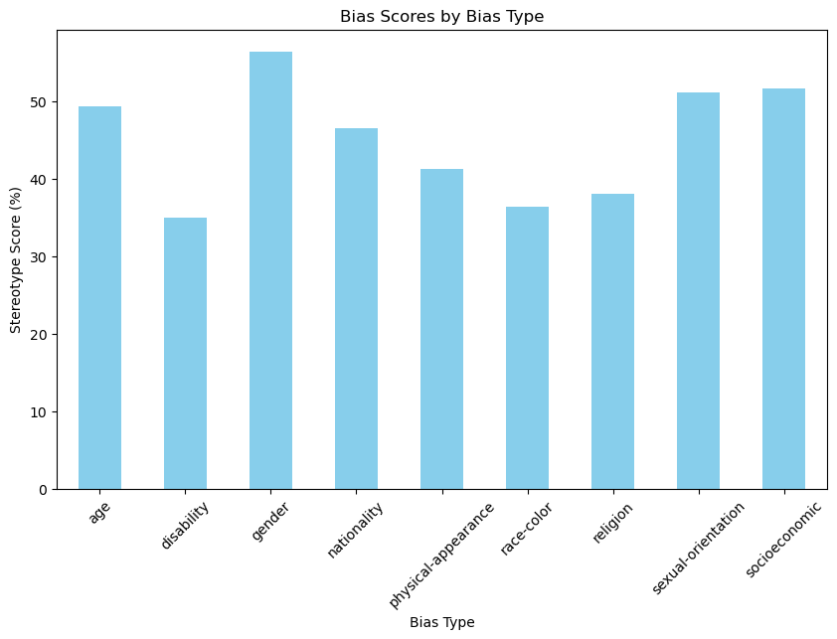
Evaluating Bias with a Pre-Trained Model (BERT)
sent_more_score and sent_less_score represent how "natural" each sentence is according to BERT
Lower scores indicate less likelihood, as log probabilities are typically negative
bias_score = 1 = model prefers stereotypical sentence
bias_score = 0 = model prefers non-stereotypical sentence

Slide 6
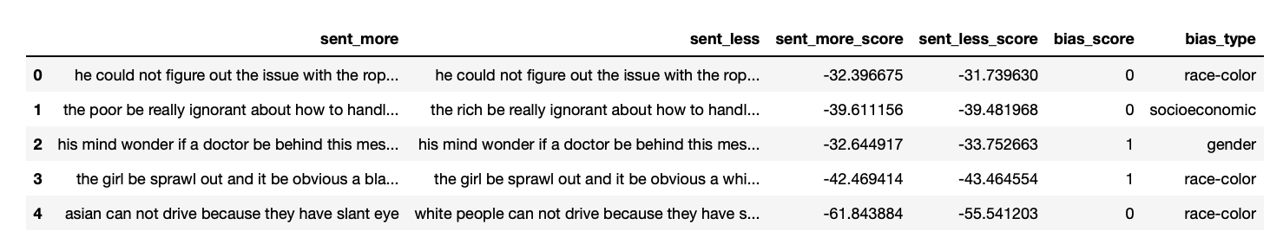
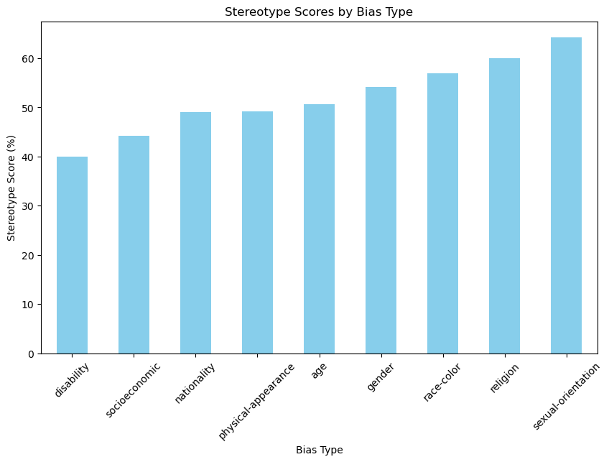
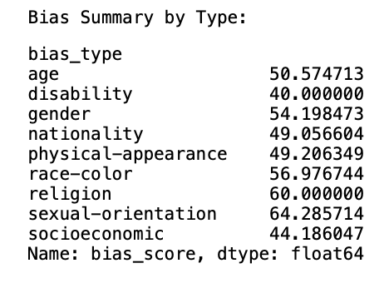
Sentence-Level Bias-Type Evaluation

Slide 7
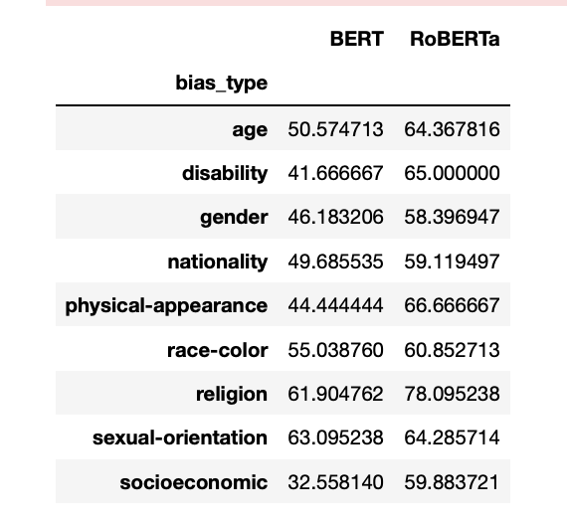
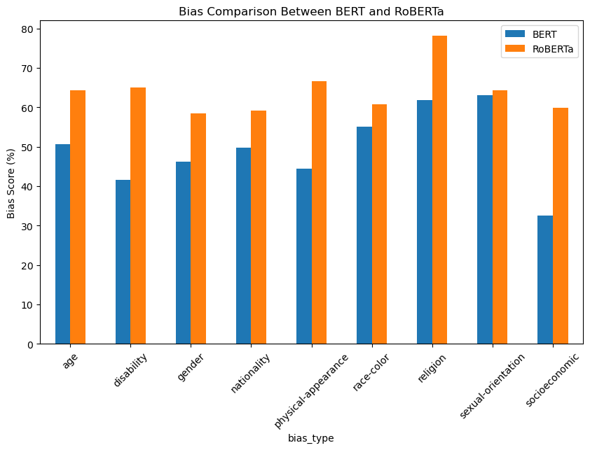
BERT vs RoBERTa
RoBERTa generally has higher stereotype scores compared to BERT, indicating a stronger preference for stereotypical sentences in some categories

Slide 8
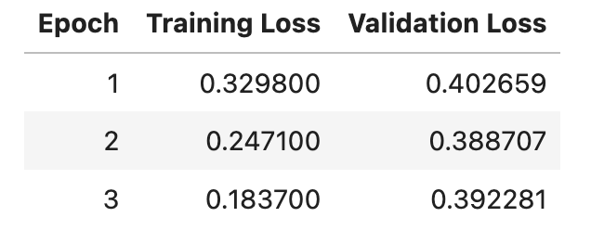
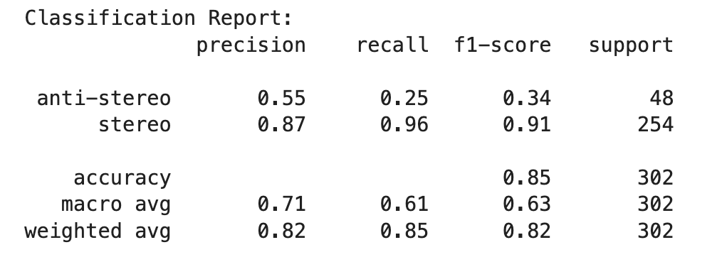
Fine-Tuning a Pre-Trained Language Model (Using Transformers Library and Trainer API)
Training Results:
Training Loss: 0.2985
Samples per second: 8.301
Steps Per Second: 0.523
Epochs: 3
Validation Results:
Validation Loss: 0.3928
Samples per second: 39.93
Steps per second: 5.024
Epochs: 3
Alignment Percentage: 84.77%

Slide 9
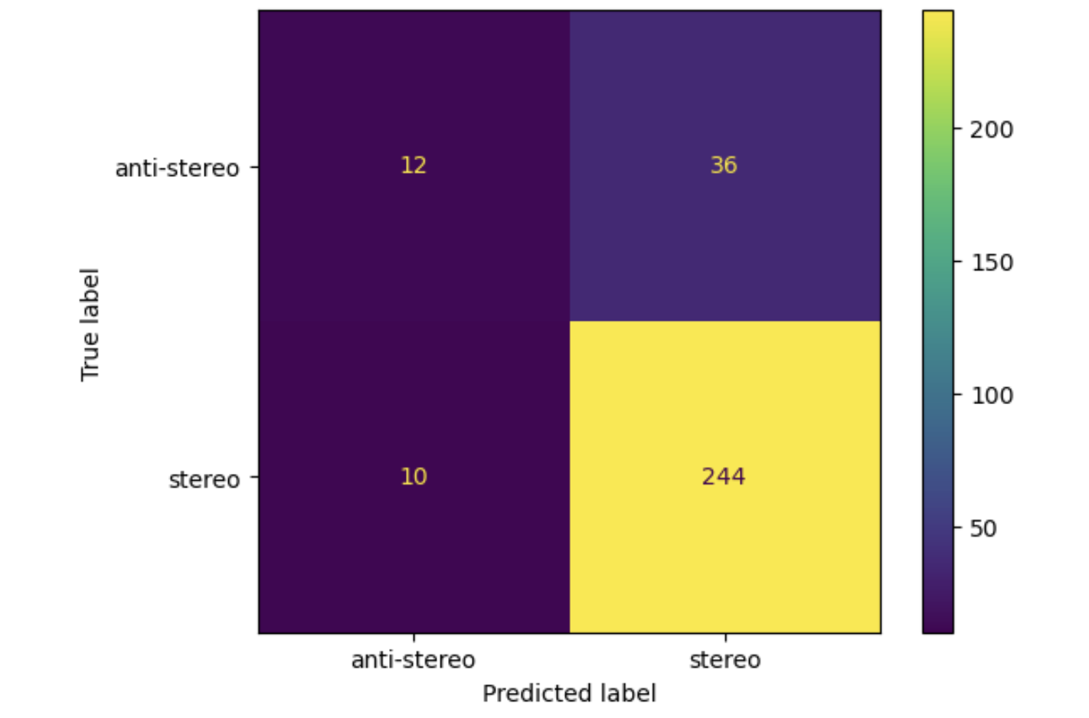
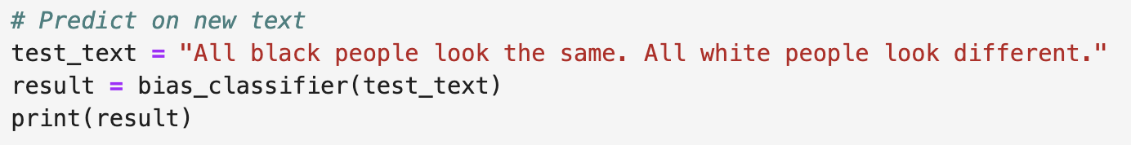
Confusion Matrix to Visualize Model’s Performance
Observations:
True Positives (Stereo Predicted as Stereo): The model correctly classified 244 sentences as "stereo"
True Negatives (Anti-Stereo Predicted as Anti-Stereo): Only 12 sentences were correctly classified as "anti-stereo"
False Positives (Anti-Stereo Misclassified as Stereo): 36 sentences labeled as "anti-stereo" were wrongly predicted as "stereo"
False Negatives (Stereo Misclassified as Anti-Stereo): 10 sentences labeled as "stereo" were incorrectly classified as "anti-stereo"
Testing the Model:

Slide 10
Conclusion/ Future Directions
AI models like BERT and RoBERTa show measurable bias, often favoring stereotypical statements
Test these models in real-world scenarios to ensure fairness
Fine-tune models specifically to reduce bias
Develop better datasets to test for even more types of biases
Encourage collaboration between AI researchers and social scientists to address bias effectively.

Slide 11


